Slide 1
Synthetic Chest X-Ray Image Generation

Slide 2
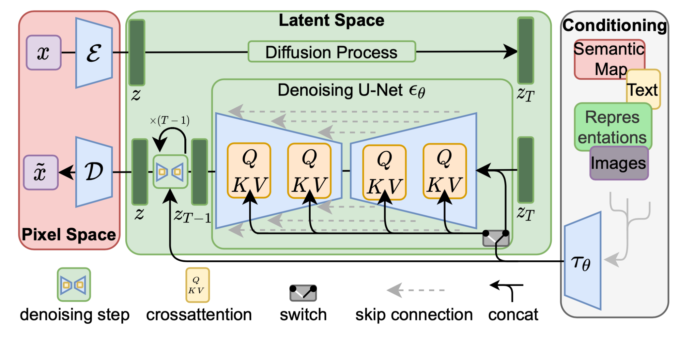
Diffusion Models

Slide 3
Hugging Face Diffusers
Python Library for SOTA pretrained diffusion models
Different model architectures, e.g., Stable Diffusion, LDM, DDPM, etc.
Able to produce data from different modalities, e.g.:
images
videos
audio
3D molecular compounds
Emphasis on simplicity and ease of use: Image generation pipeline in a few lines of code
Useful code examples: inference, training, different model type training and inference
Different training settings, e.g., LoRA, DreamBooth
Many different pretrained architectures available
In short: many models and code examples which can (easily?) be adapted to your needs
https://github.com/huggingface/diffusers
https://huggingface.co/

Slide 4
RoentGen Thesis: Background and Motivation
DNNs good at disease classification in CXRs
DNNs can suffer from bias against minority groups:
Imbalance of classes and attributes
In a medical context, it is critical to find this bias
Investigate classifier performance and bias using synthetic data
Text-to-image Latent diffusion model

Slide 5
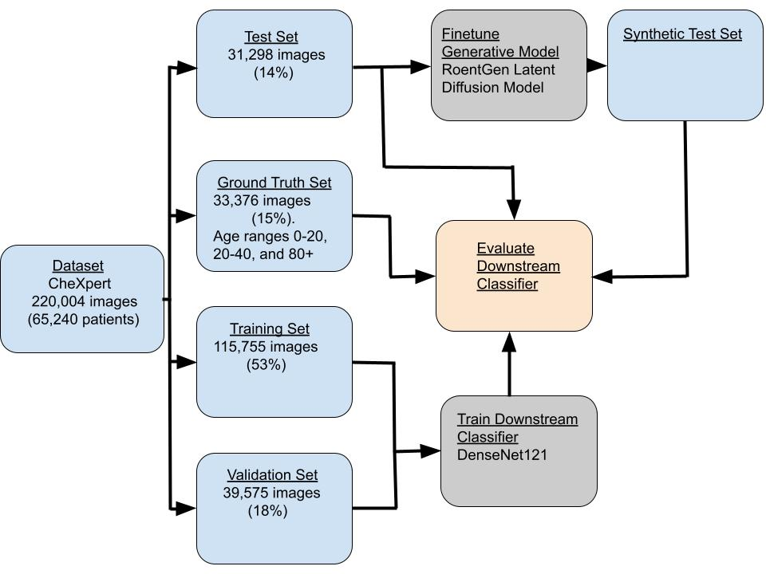
Thesis Methodology: Evaluation Framework

Slide 6
Methodology: Generative Model
CheXpert dataset
Split
RoentGen, finetuned on MIMIC-CXR
We further finetune on test set of CheXpert
Views: Frontal, Lateral, AP/PA (All)
Detect rotated training images, rotate them back
Prompting: attributes & classes→simple text prompt
E.g.: “male, age group 40 - 80, view frontal, projection ap, edema”
“female, age group 80+, view frontal, projection pa, atelectasis, support devices”
Train both UNet and Text Encoder (freeze VAE)
Train
Valid
Ground Truth
Test
Finetune RoentGen

Slide 7
Fidelity & Diversity of Synthetic Images
Fréchet Inception Distance (FID) —> Fidelity
How close the distributions of synthetic and real-world images are
Lower values —> higher fidelity
Default model Inception v3 may be out of domain —> Use more models, including an in domain model
Multi-Scale Structural Similarity Index Measure (MS-SSIM) —> Diversity
Compute between images for a given prompt
Lower MS-SSIM values (~0.0) —> higher diversity
Higher MS-SSIM values (~1.0) —> images are more similar to each other

Slide 8
Evaluating Synthetic Data
Fidelity
FID- InceptionV3, CLIP-ViT-B/32 [28], DenseNet-121 (in domain)
MS-SSIM (diversity)
Conditioning
Attribute classifier- Train classifier on synthetic data, attributes as labels. Test on real world data. (and vice-versa). Attributes to classify: Age group, sex, image view and projection
Utility for model training
Train classifier on real + varying amounts of synth. data.
Investigate impact of different amounts of synthetic data
Utility for model evaluation
Downstream classifier performance on synth. vs. real data
Consistency- performance ranking of classifiers on synth. vs. real data

Slide 9
Methodology: Generative Model Checkpoint Selection
Difficult to select checkpoint from training
Quick checkpoint evaluation scheme
Select n checkpoints from training
Generate small quantity of images with each checkpoint (as hardware permits)
fidelity (FID) and diversity (MS-SSIM) for each set of images
Inspect images by eye
Select checkpoint with best metrics and best looking images

Slide 10
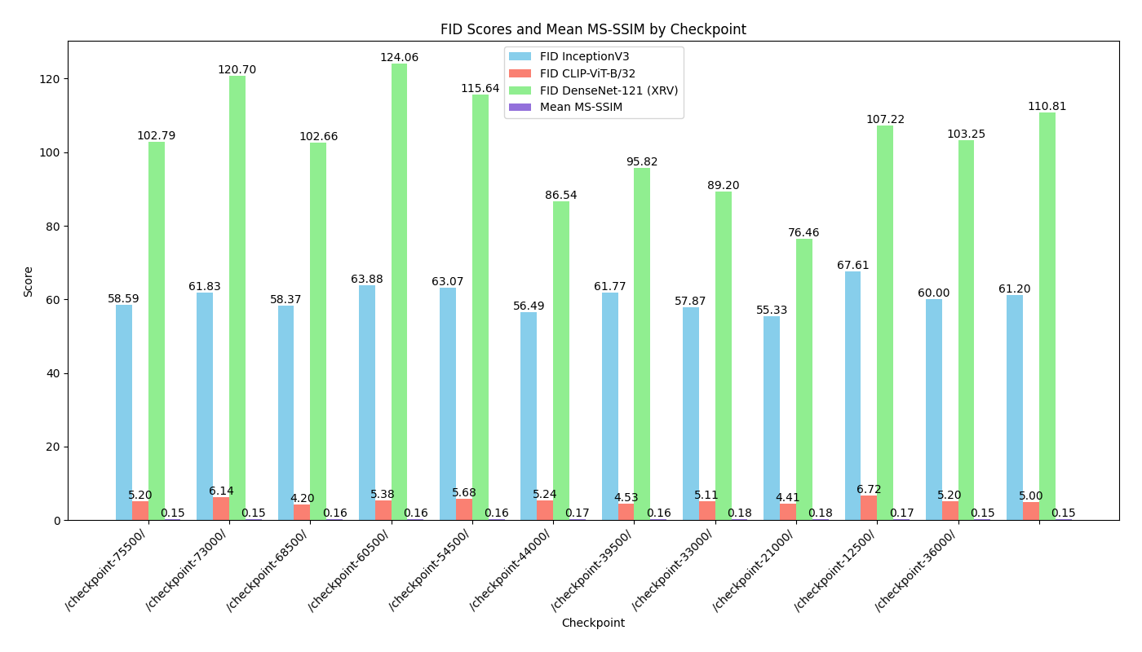
Results: Generative Model Checkpoint Selection
Selected Checkpoint: 44,000 training steps

Slide 11
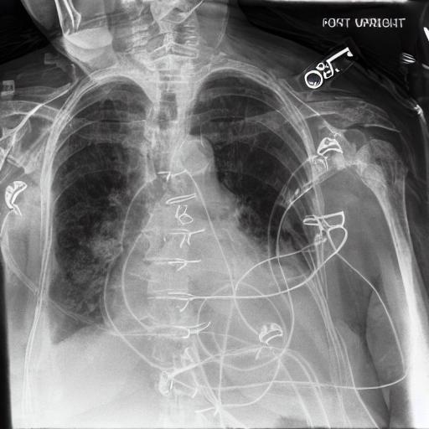
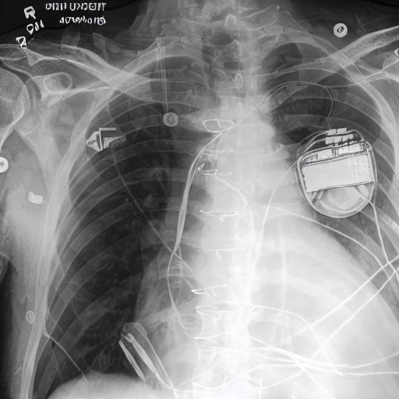
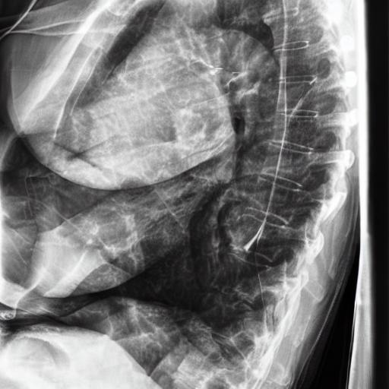
Synthetic CXR Images (Acceptable samples)

Slide 12
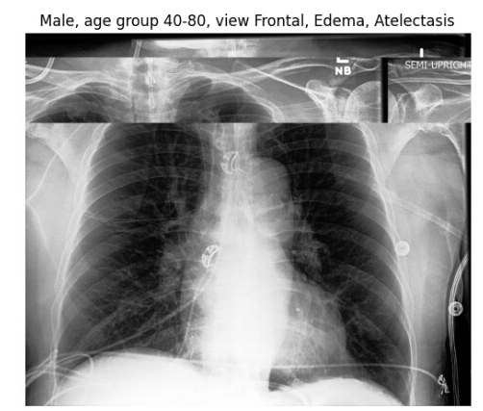
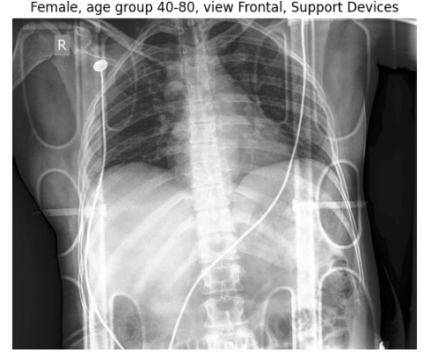
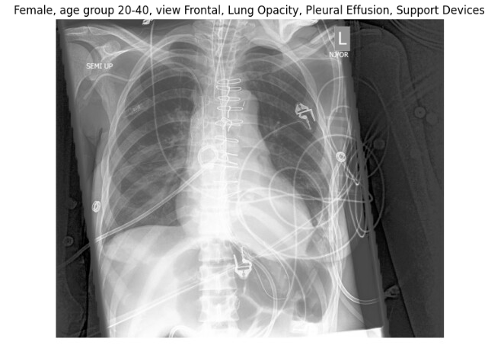
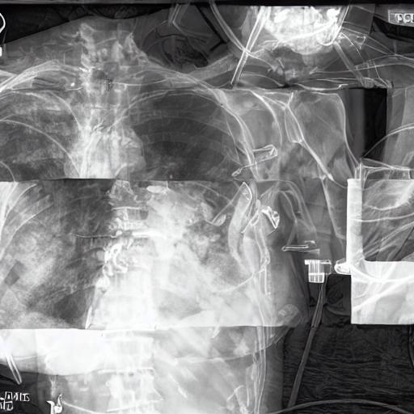
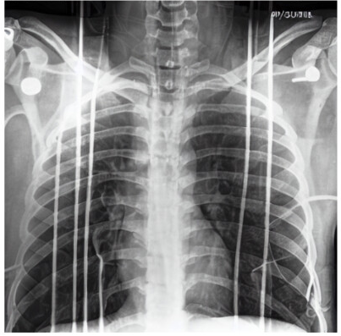
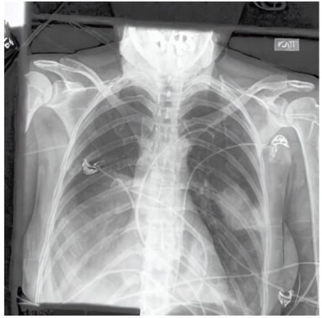
Image Properties Transfer
Real:
Synthetic:

Slide 13
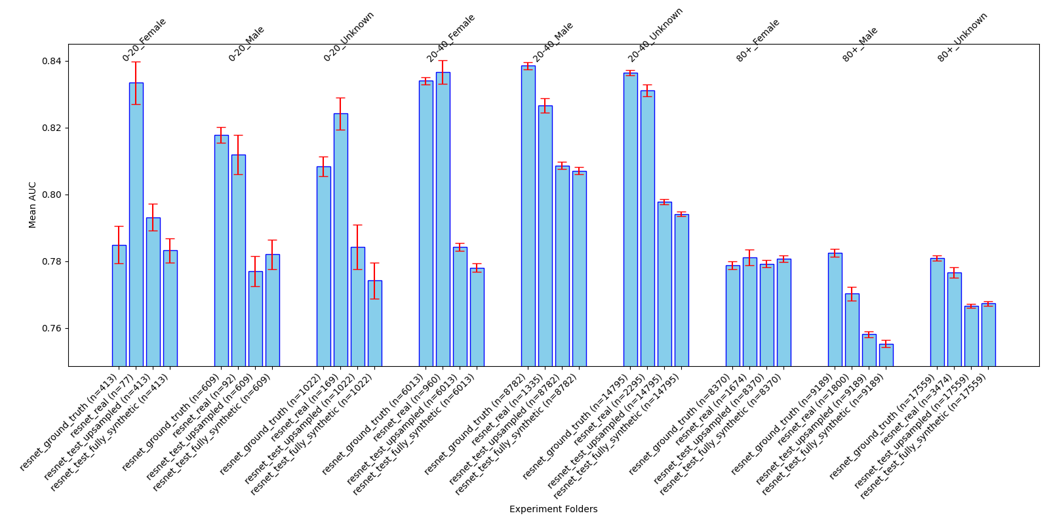
Results: Classifier Inference on Real vs. Synth. Data
ResNet on minority subpopulations

Slide 14
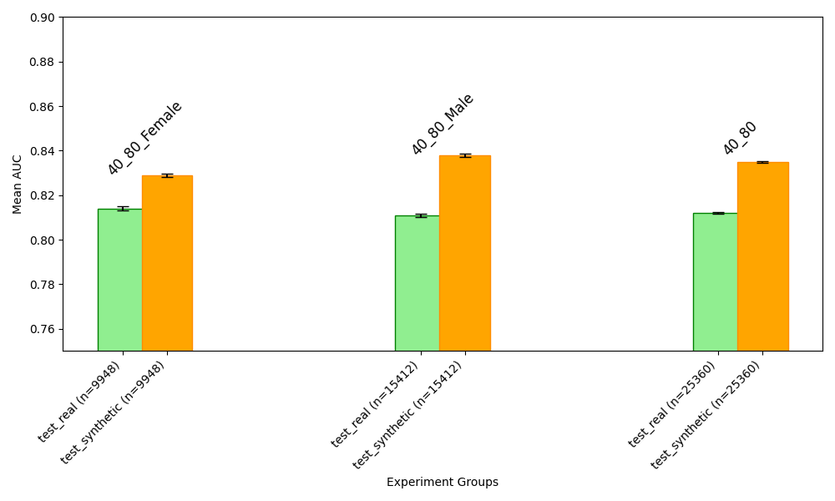
Results: Classifier Inference on Real vs. Synth. Data
ResNet on majority subpopulations

Slide 15
Appendix

Slide 16
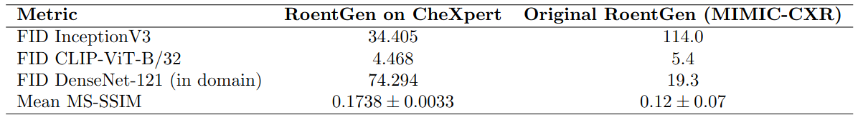
Appendix: Fidelity & Diversity
FID InceptionV3 scores different, perhaps due to different implementation
FID CLIP-ViT-B/32 similar scores
FID DenseNet-121 much higher in this work, but used different DenseNet-121 trained on different data.
MS-SSIM matches, both are close.
Original RoentGen had up to twice as high numbers when not including all CXR views in training

